Slide 1
Prepare the environment for a Microsoft Teams deployment

Slide 2
Module agenda
Upgrade from Skype for Business to Microsoft Teams
Plan and configure network settings for Microsoft Teams
Deploy and Manage Microsoft Teams endpoints

Slide 3
Upgrade from Skype for Business to Microsoft Teams

Slide 4
Lesson introduction
After this lesson, you will be able to:
Explain different upgrade paths for coexistence and upgrade modes
Manage the migration for meetings
Configure coexistence and upgrade settings

Slide 5
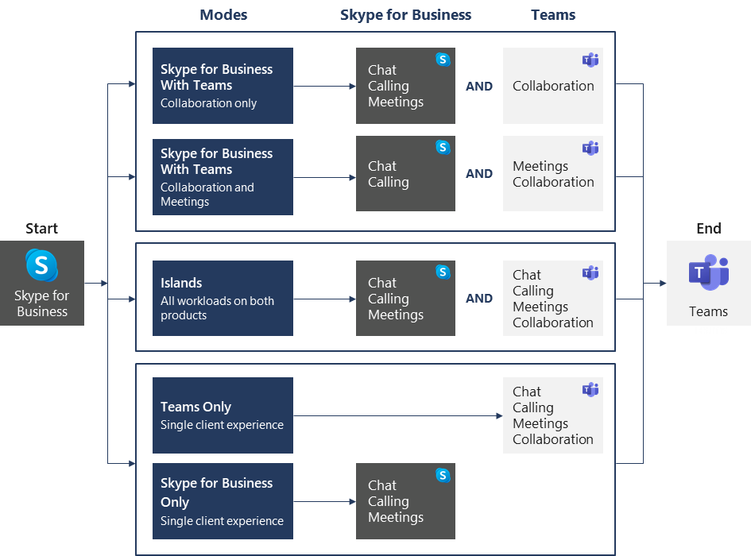
Evaluate upgrade paths with coexistence and upgrade modes
Two upgrade journeys:
Direct upgrade journey
Gradual upgrade journey
Notes:
Supporting videos for instructor or student use:
Introduction to Upgrade from Skype for Business to Microsoft Teams
https://www.youtube.com/watch?v=0COYetLjWmE

Slide 6
Manage meeting migration
Meeting Migration Service (MMS) provides updates for existing meetings:
When a user is migrated from on-premises to the cloud (SfB Online or to TeamsOnly)
When an admin makes a change to the user’s audio-conferencing settings
When an online user is upgraded to Teams only
When you use PowerShell to trigger MMS
Admins use Skype for Business Online PowerShell module to check the status of running migrations, manually trigger meeting migrations, and disable migrations
MMS is enabled by default for all organizations, but it can also be disabled on different levels:
Disable entirely for the tenant
Disable only for changes related to audio conferencing

Slide 7
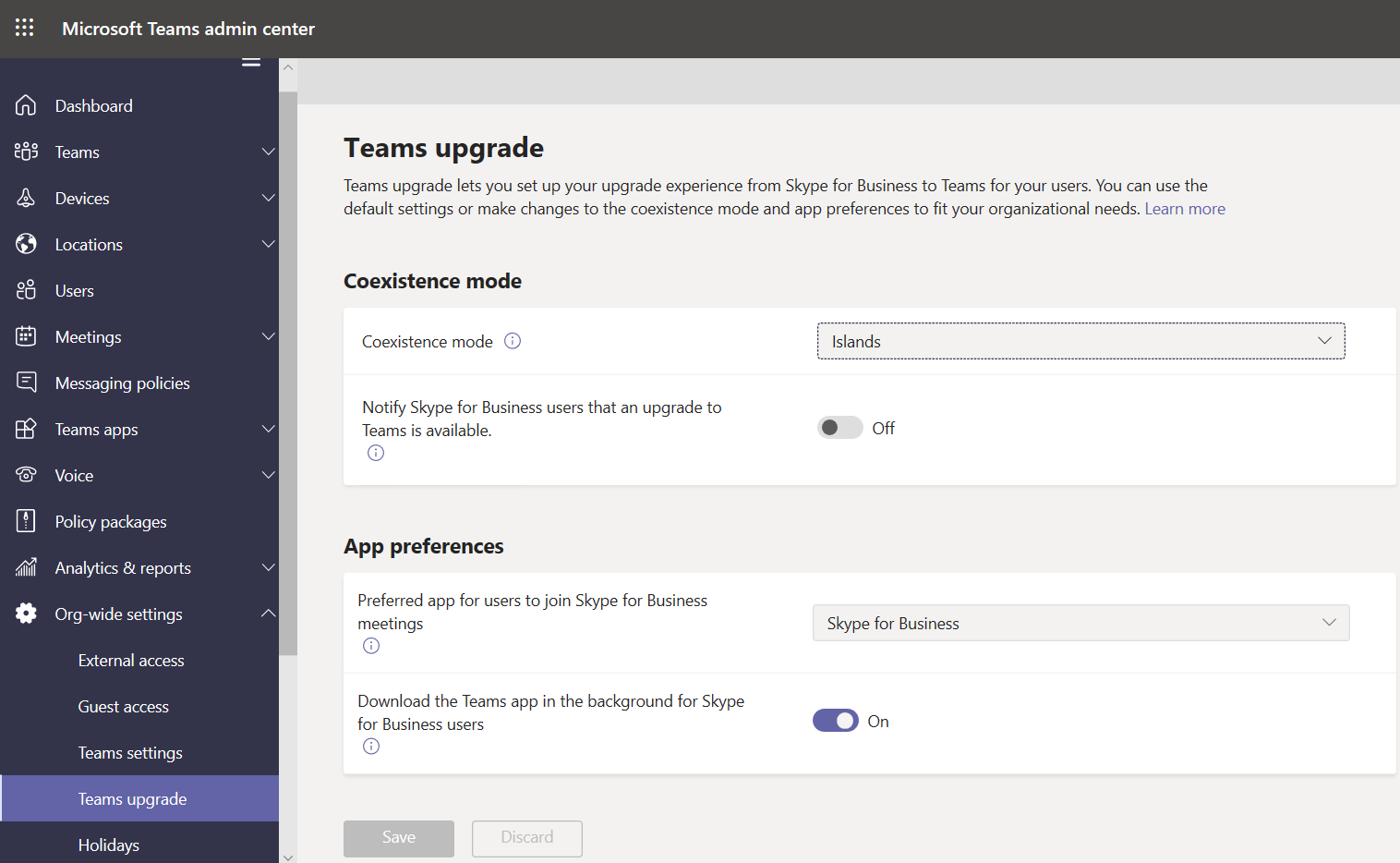
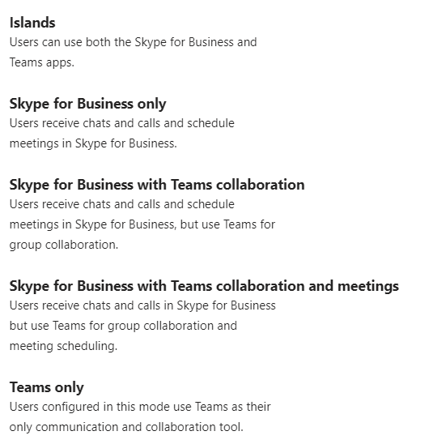
Configure coexistence and upgrade settings

Slide 8
Plan and configure network settings for Microsoft Teams

Slide 9
Lesson introduction
After this lesson, you will be able to:
Explain the network requirements of Microsoft Teams
Work with the Network Planner tool
Utilize the Network Test Companion
Describe the required network ports and protocols
Configure reporting labels for Microsoft Teams
Implement Quality of Service in your environment

Slide 10
Overview of Teams networking requirements
Three types of network traffic directions:
Data traffic between the Office 365 Online environment and the Teams client
Peer-to-peer real-time communications traffic
Conferencing real-time communications traffic
Analyze network capabilities (connectivity to Office 365, network quality, network health, available bandwidth, VPN, Wi-Fi, proxy servers)
Plan your network requirements (example: max. concurrent users)
Notes:
Supporting videos for instructor or student use:
Network Planning for Microsoft Teams
https://www.youtube.com/watch?v=vi3M7ZzF2NU

Slide 11
What is call quality?

Slide 12








User scenario: Good vs. bad experience
Good experience
She is able to call other people and join meetings.
She has an uninterrupted, natural conversation.
She can see the other person well and can be seen.
She can follow a presentation that is shared in the meeting.
She can focus on the conversation.
Bad experience
Sometimes she cannot call others or has challenges joining meetings.
Others are difficult to hear due to echo and noise. People start talking at the same time.
The video seems to be asynchronous and blurry.
The presentations seems to lag behind and she cannot follow the presenter.
She gets distracted by the technology.

Slide 13
What defines quality?
Call Reliability
Calls get established as expected
Calls do not drop midway through
Media Quality
Users are able to hear and see everything they need to in their calls
Who Matters
User quality of experience
Can I make calls successfully?
Admin quality of life
Can I discover, diagnose, and resolve voice quality issues effectively?

Slide 14



Media quality influencing factors
Environment
Acoustical noise
Visual noise
Device
Device for capturing audio and video
Device for playing back audio
Network
Quality of the network
Available bandwidth
Connectivity to Office 365 network

Slide 15
Environment
How can it affect quality?
Loud environments can affect capturing and playing back audio
Bad lighting and busy backgrounds can affect video
What IT can do?
Work with facility management to provide appropriate rooms for calls and meetings
What users can do?
Move to a location appropriate for a call

Slide 16
Devices
How can they affect quality?
Audio devices have different ability to suppress background noise and reduce echo
Webcams provide different levels of quality
Poor device choice will affect the other people on a call or meeting
What IT can do?
Provide qualified devices to end users
Equip meeting rooms with Teams rooms systems
What users can do?
Using the microphone built into a Laptop is always the worst option
Use a device appropriate for the situation

Slide 17


Microsoft certified devices
End-User Benefits Plug and play
Predictable call controls across all certified devices
High quality wideband audio that provides natural sound
Tested for echo and noise cancellation
Microphone optimization for clear voices and eliminate cross-talk
High camera video quality tested for low light video, image detail, non-jitter, latency, and frame rate
Administrator Benefits
No provisioning required
Remotely update firmware to allow new features and performance improvements
Independent lab verified
https://aka.ms/teams-devices

Slide 18
Network
How can it affect quality?
Network metrics like jitter, delay and packet loss will affect user experience
What IT can do?
Provide high quality network with appropriate bandwidth
Connectivity to Office 365 network as direct as possible
Network planning: https://aka.ms/teams-networking
What users can do?
Prefer wired networks over wireless
Consider Wi-Fi reception

Slide 19
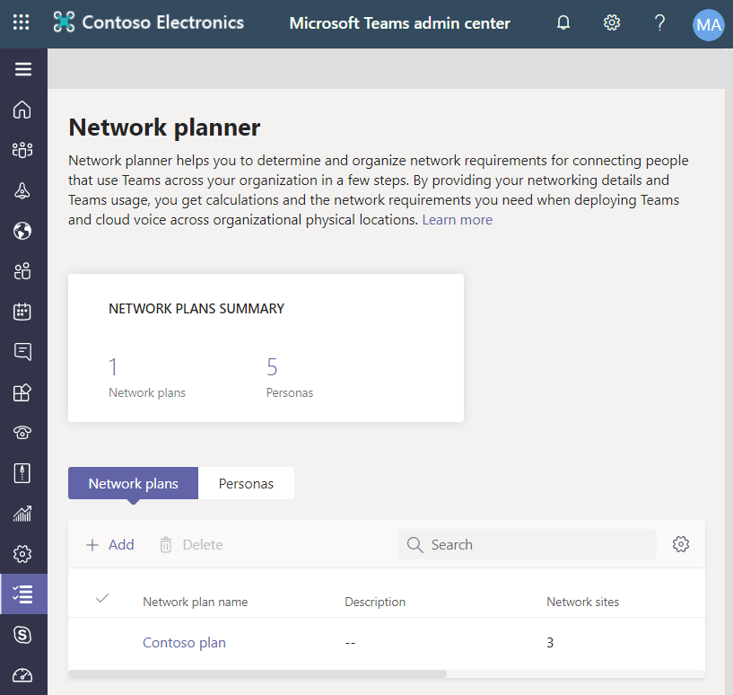
Use the Network planner
Network planner features:
Generate reports and calculate bandwidth requirements for Teams usage
Create representations of your organization using sites and Microsoft recommended personas
Required permission to access Network planner:
Global Administrator,
Teams Service Administrator,
Teams Communications Administrator.
Create a custom persona
Build your plan
Create a report

Slide 20
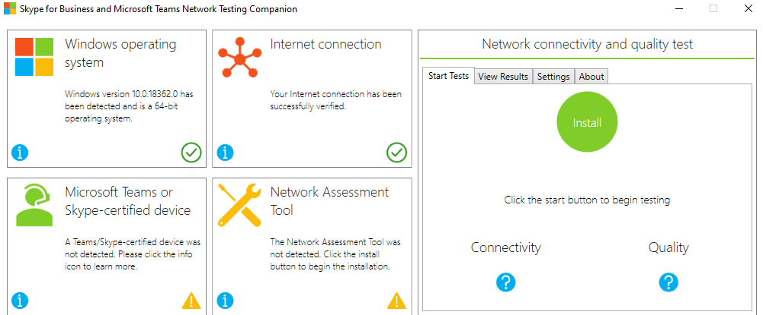
Use the Network Testing Companion
Network Testing Companion is used to test the network quality and connection to Skype for Business Online or Microsoft Teams
Notes:
Recommend to demo the tool.

Slide 21
Configure network ports and protocols
All clients that use Office 365 cloud-based services, including Microsoft Teams, need to connect to the Office 365 endpoints, which represent set of destination IP addresses, DNS domain names, and URLs for Office 365 traffic on the Internet
These endpoints change regularly. It is critical that you adopt a change management process for Office 365 endpoints
Scenario | Source IP/Port | Destination IP/Port
Non real-time traffic | Client IP High ports | Office 365 80, 443 TCP
Real-time media traffic | Client IP 50,000-50,059 UDP | Transport Relays 3478-3481 UDP

Slide 22
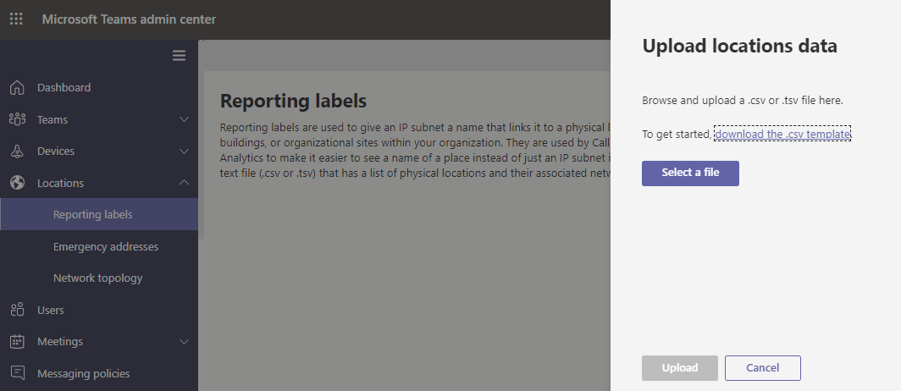
Configure reporting labels for Microsoft Teams
Use reporting labels to organize the physical locations of offices, buildings and organizational sites. The report labels and locations data are used for generating reports for Call Analytics and the Call Quality Dashboard

Slide 23
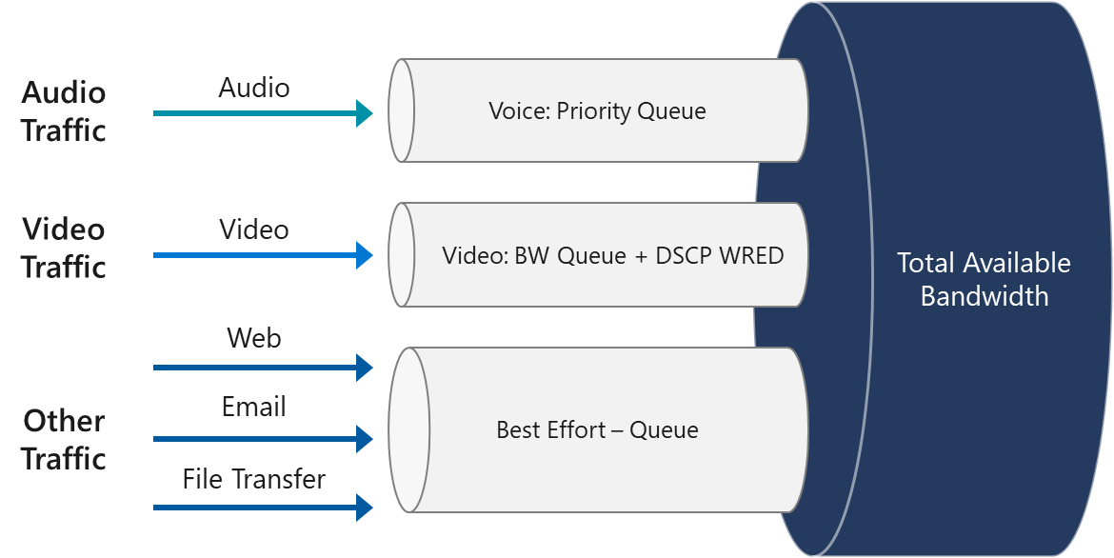
Implement Quality of Service (QoS)
Quality of Service (QoS) is a mechanism you use to prioritize certain types of network traffic
Implement QoS:
Verify if a network is ready for QoS
Select a QoS implementation method
Choose initial port ranges for each media type
Implement QoS in the Teams admin center
Validate the QoS implementation
Migrate a QoS solution to Teams

Slide 24
Deploy and manage Microsoft Teams endpoints

Slide 25
Lesson introduction
After this lesson, you will be able to:
Deploy Microsoft Teams to devices
Manage device settings and firmware
Manage configuration profiles
Configure Microsoft Teams Rooms

Slide 26
Deploy Microsoft Teams clients to devices
Operating systems for Teams desktop clients:
Windows (8.1 or later) and Windows Server (2012 R2 or later), 32-bit and 64-bit versions
MacOS 10.10 and later
Linux .deb and .rpm formats
Operating system for VDI
Teams mobile clients:
Android
iOS
Web client
Client update management

Slide 27
Manage device settings and firmware
For a device to be managed in Teams Admin Center, it must be certified for Teams and enrolled in Teams
Management tasks:
Change device information
Manage software updates
Restart a device
View device history
View diagnostics
Notes:
https://products.office.com/en-us/microsoft-teams/across-devices

Slide 28
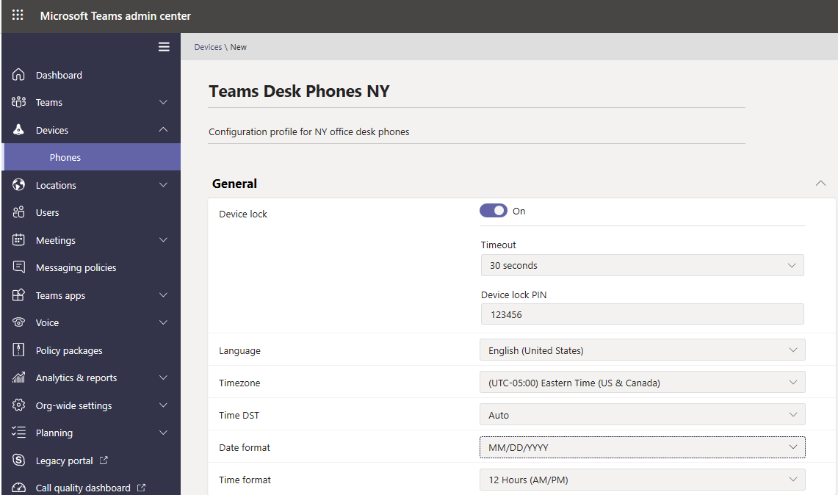
Manage configuration profiles
Manage settings and features for Teams devices in your organization
Create a configuration profile
Assign a configuration profile
Notes:
Supporting videos for instructor or student use:
Microsoft Teams Phones and Peripherals for enhanced meeting and calling experiences
https://myignite.techcommunity.microsoft.com/sessions/83485?source=sessions

Slide 29
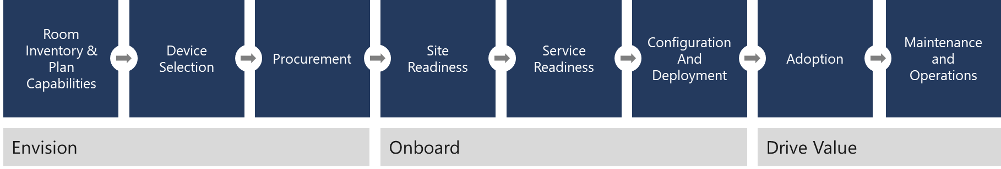
Configure Microsoft Teams rooms
Account provisioning
Microsoft Teams Rooms application and peripheral device configuration
Device software installation
Testing
Device deployment
Asset management
Microsoft Teams rooms deployment
Notes:
Supporting videos for instructor or student use:
Transform every meeting with Microsoft Teams Rooms:
https://www.youtube.com/watch?v=5VBRa4s1hVM

Slide 30
Lab: Plan and configure network settings for Microsoft Teams

Slide 31
Lab exercises
Exercise 1: Calculate Network capabilities
Exercise 2: Evaluate configuration profiles
Exercise 3: Provide Teams resources

Slide 32
Closing slide

